Slide 1


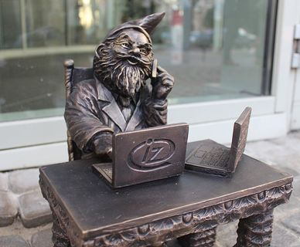
MONEYBALL
Mateusz Guściora

Slide 2



Good morning, everyone
About my studies
Moneyball
Why it is interesting
Conclusion
Q&A

Slide 3
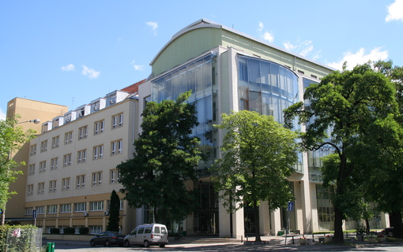

Introduction v1
Wrocław University of Science and Technology
Faculty of Computer Science and Management
My major is Engineering of Management
Specialization is Applications of IT in bussiness

Slide 4


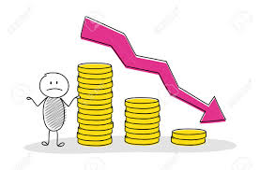


Introduction v2
Bachelor of Science (B.Sc)
Classes, Lecturers:
IT
Economics
Management
Group projects

Slide 5
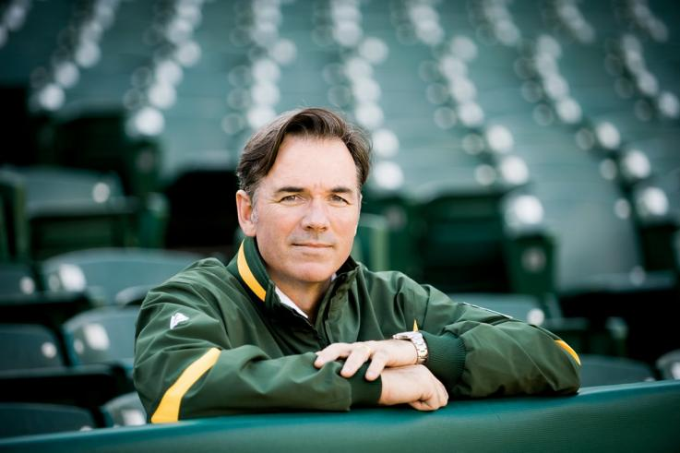

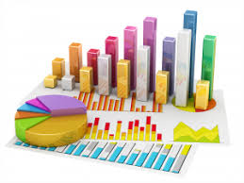
Moneyball
Story of Billy Beane menager of Oaklend Athletics-baseball team.
Billy Beane used statistical method to gain an advantage in assembling and managing his baseball team.
Creative way of combining technology with management skills in sport.

Slide 6

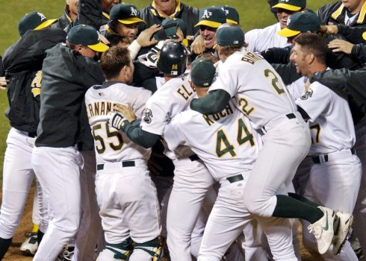
Moneyball-Oakland Athletics
After 2001 season Oakland Athletics sold their bigest stars in their team.
Team's general manager, responded with a series of free agent signings due to a low budget in comparison to other teams in baseball league.
It led to winning 20 games in a row.
Competing in play-offs in 2002 and 2003.

Slide 7

Moneyball-data analasys
Cutting-Edge method.
Gathering database and then using statistical and mathematical methods to manage the team.
Signing on players, line up, trainings other decisions.

Slide 8

Moneyball-the movie
Based on the book Moneyball: The Art of Winning an Unfair Game which is based on the story of Billie Bean’s Oakland Athletics’s 2002 season.
Ambition, effectiveness, ingenuity.
Managing sport team using computer analysis.

Slide 9

Conclusion
Faculty of Computer Science and Management.
Moneyball is the name of book and movie and the term about using statistical analysis in sport.
Billy Beane, sport’s manager was using cutting-Edge method (Baseball statistic analysis).
It allowed him to compete with much „richer” teams and ending season with record of 20 games won in a row.

Slide 10

Finale statemant
Being innovative and showing ingenuity is very important nowadays, it can be huge game changer in many areas of life.

Slide 11

Q&A

Slide 12
References
http://pwr.edu.pl/en/
https://www.google.pl/
http://prosperity.memes.pl/dok11043,przestanmy-mowic-o-%E2%80%9Emoneyball%E2%80%9D-jak-o-%E2%80%9Ebig-data%E2%80%9D.htm
https://pl.bab.la/
https://en.wikipedia.org/wiki/2002_Oakland_Athletics_season
https://www.filmweb.pl/film/Moneyball-2011-490838

Slide 13

Thank you

